Slide 1
Notes:
This is Herstory Writers Workshop, a tree of life that uses memoir to create justice movements, with more branches sprouting every year, founded on a unique pedagogy that dares a reading stranger to care,

Slide 2
Notes:
It is more than just a workshop,. As those whose voices have been silenced find their words, they become powerful activists, changing hearts, minds and policy.

Slide 3
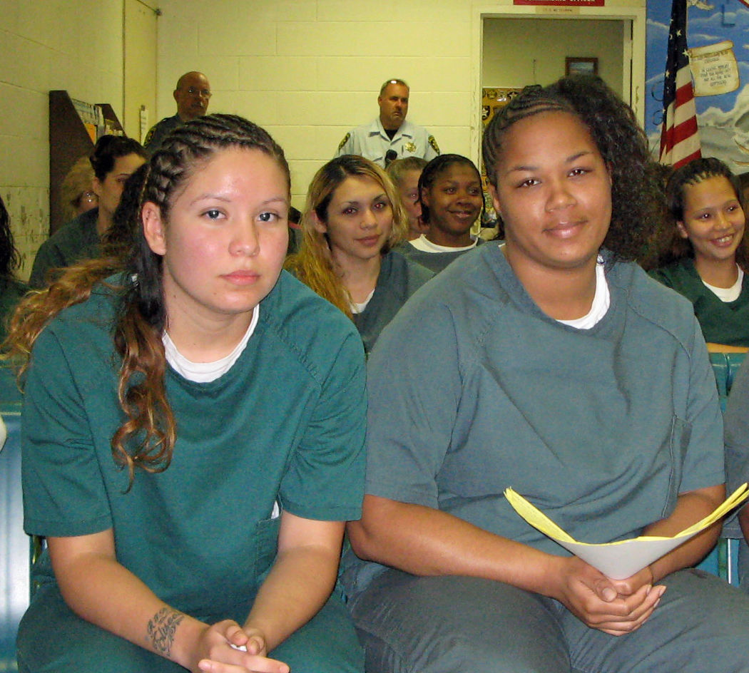
Notes:
We work in the schools, in the jails and in the community. We work in Spanish and English, with the incarcerated and the free.

Slide 4
Notes:
It is a place where books are born. Things happen around them the writers could not have imagined. VOICES, our jail anthology, was made mandatory reading by Suffolk County’s Correctional Academy. No officer could guard the women without knowing their stories.

Slide 5
Notes:
We work with the young and the old.

Slide 6
Notes:
As more people grew interested in using our tools, we created our manual, Paper Stranger, the centerpiece of our training institute at Hofstra University. We thank our LitTAP mentor Gloria Jacobs, for her help in conceptualizing the institute.

Slide 7
Notes:
As we moved into working in the schools, we created a special manual for younger writers, This book, originally designed for Stony Brook University’s Educational Opportunity Program is now the centerpiece of our Youth Writing for Justice project.

Slide 8
Notes:
Whether we are working in a school, jail or community setting, we begin daydreaming a page one moment that will open a window into each writers’ life. Collectively we witness the stories taking shape before an audience that cares.

Slide 9
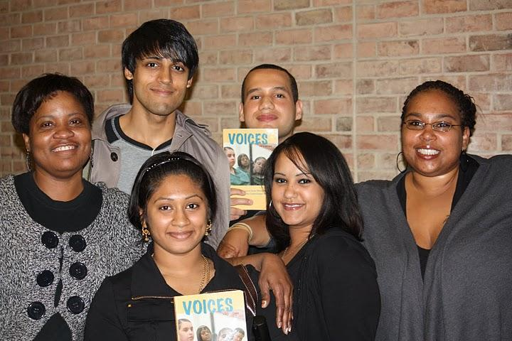
Notes:
And then, when the work is done, writers make the choice about bringing it into the world. Here three women who started writing in jail join students from Queensboro Community College, where they have given a reading from their newly published book

Slide 10
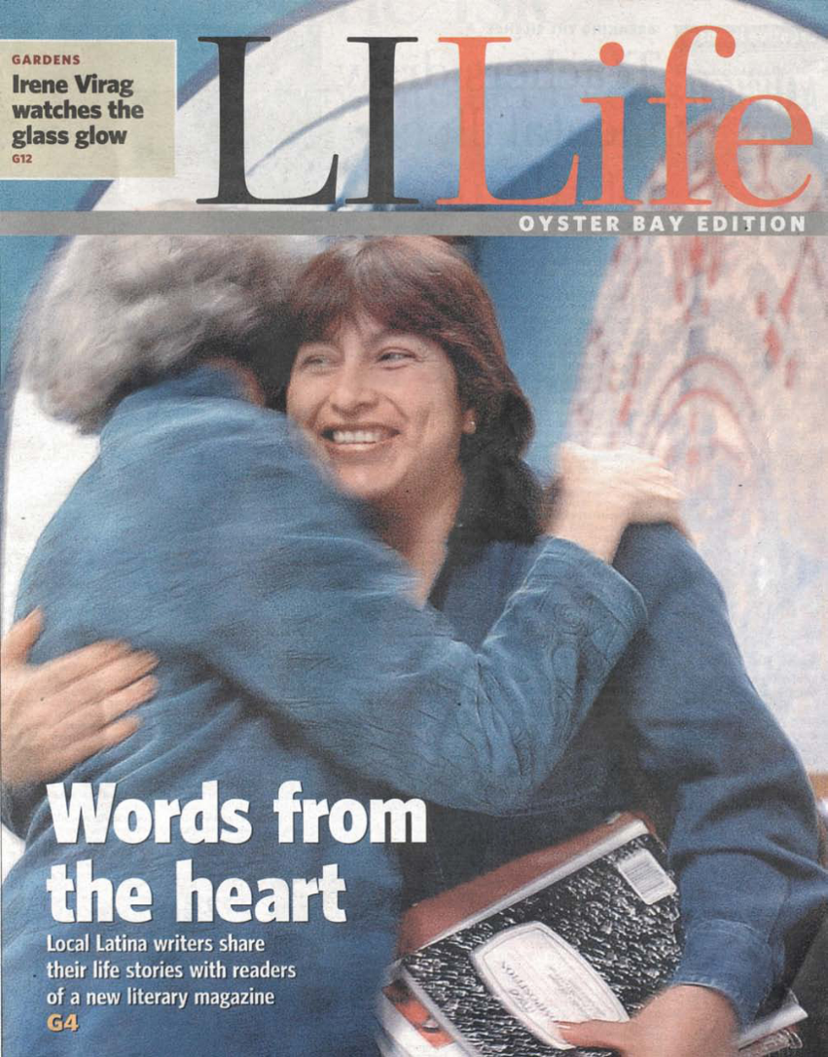
Notes:
For there is nothing quite so empowering as knowing that your words reached the heart of another in a way that might actually change your world.

