Slide 1
Summer 2020
Remote Writing Workshops
Presenters: Erika Duncan, Artistic and Executive Director, Herstory Writers Workshop
Susanne Marcus, NYS TESOL Past President

Slide 2
About Herstory
Founded on Long Island in 1996 by novelist and essayist Erika Duncan with the aim of giving voice to women whose stories have been silenced, empowering them through passing along the “dare to care”– the cornerstone of Herstory’s philosophy, the organization has helped thousands of women and girls – and more recently men and boys to use the memoir form to change hearts, minds and policy.

Slide 3
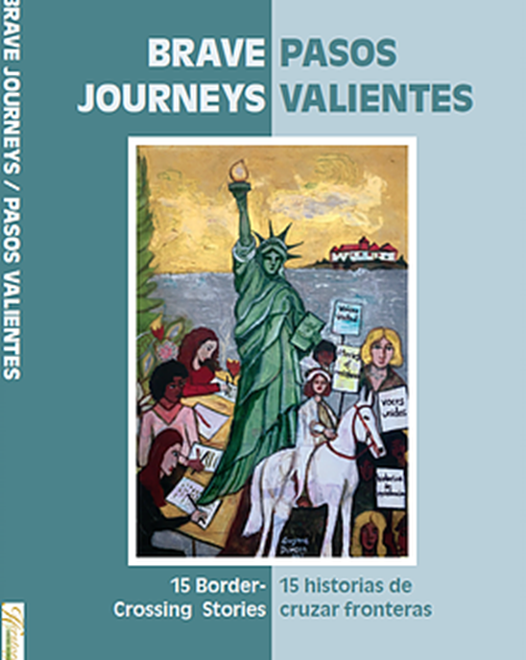
About Herstory
Herstory conducts workshops in a variety of formats in school, community, and jail-based settings, including day long retreats in partnership with school districts, universities and justice organizations, while our webinar program and publications reach beyond Long Island’s shores.

Slide 4
Herstory Initiatives
School Districts
PD for Teachers, Administrators, and Guidance Staff
In-district/In-class Facilitation with Students
Central Islip
Patchogue-Medford
Hempstead
Extensive After-School Programs in Other Districts
Universities
Communities
Credit-bearing Facilitator Training on Herstory Pedagogy
Stony Brook
Supervised Field Placements
Incarcerated Women & Girls
Immigrants & Dreamers
Parenting Groups
Human Rights Groups

Slide 5
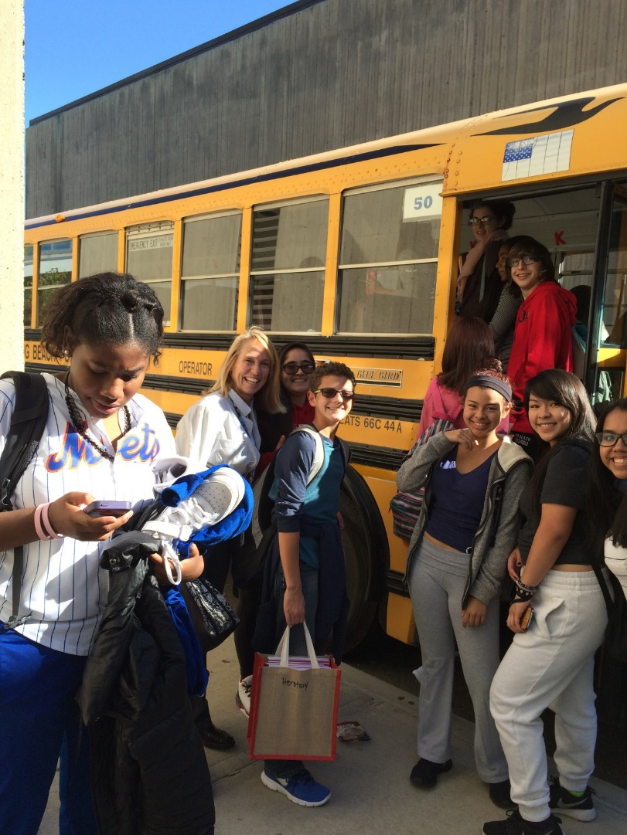
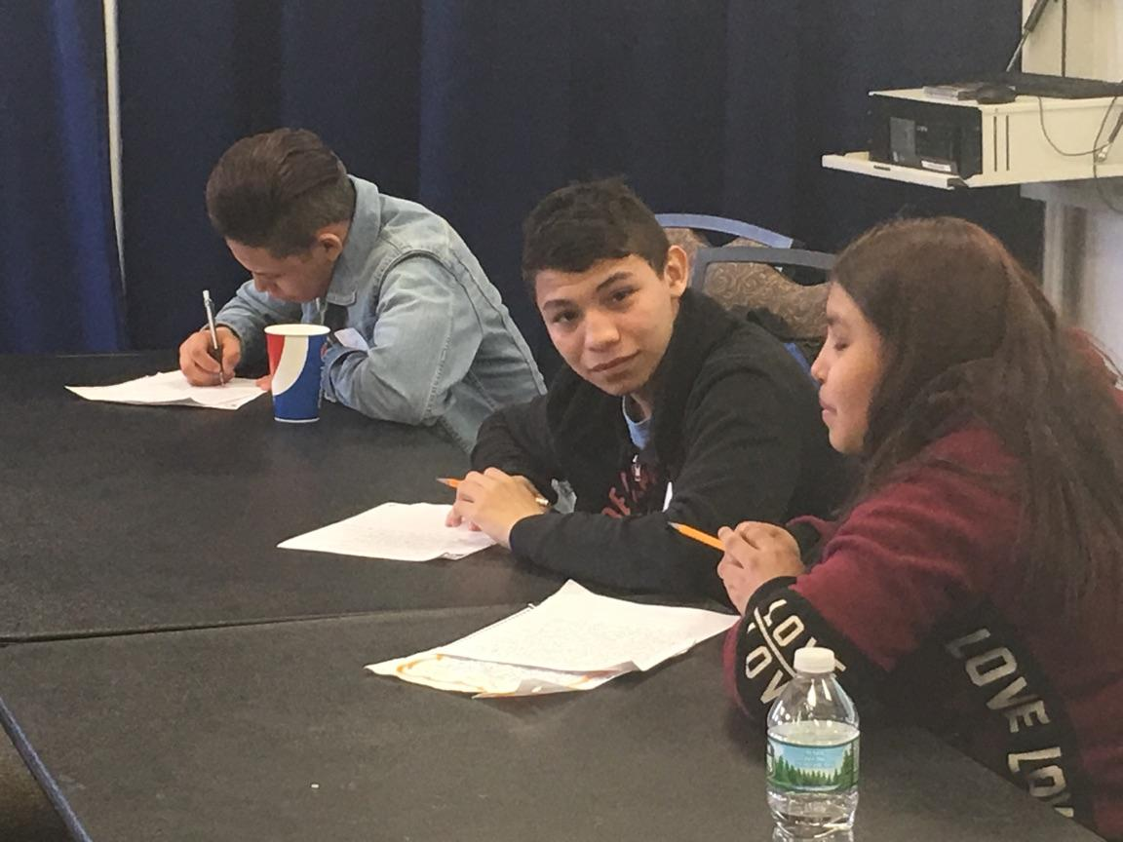
Bringing high school students to write on college campuses
Working side by side with Public Humanities, English, Modern Languages, Education, Criminology, Social Work, Civic Engagement sociology, English, and Psychology students, finding commonalities in their tales.

Slide 6
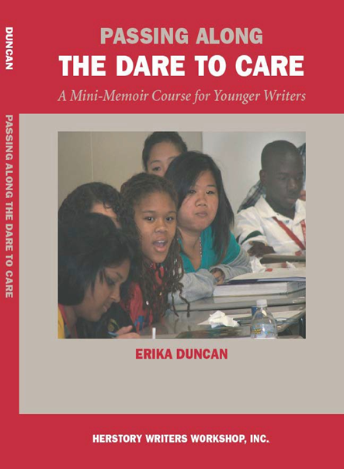
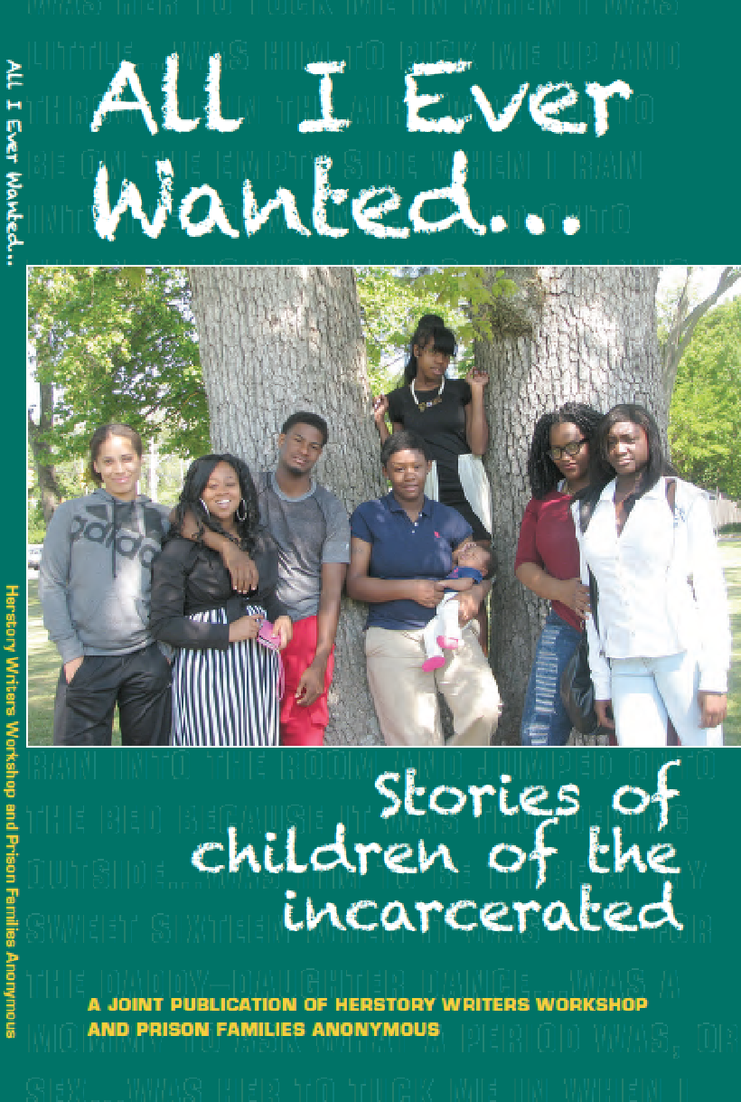
Offering student-written anthologies for use in the classroom, along with publication, web-posting and presentation opportunities

Slide 7
The underlying burning question of HERSTORY speaks to NYS TESOL’s commitment to advocacy.
Can the stories of the disenfranchised, the vulnerable and isolated, be shaped in a way that will startle those in power into rethinking policy and practice?

Slide 8
Newest Initiative June 2020 in response to Covid-19 Pandemic
College
High School
Current ESL
Former ELL
Bilingual High-Intermediate/Advanced
Adult Ed
Transitioning
Commanding
Former ENLs
Close to high school age
In between high school & college

Slide 9
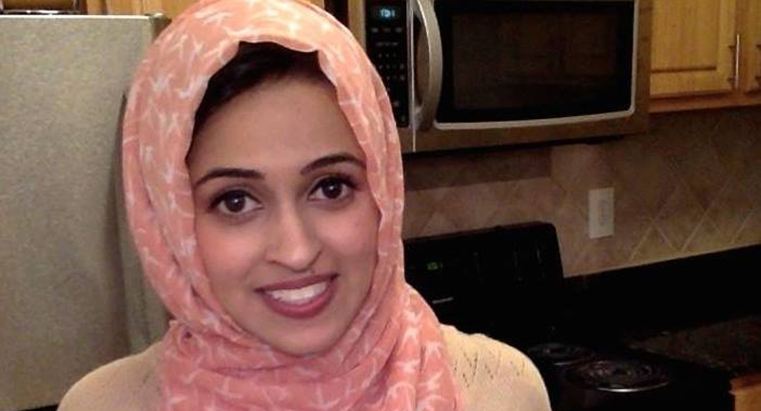
Have you ever told a student:
You should write this story!
Others can learn from your experiences!
People need to know this!
Your story can inspire others!
Please, share your story.
The world must read this story!
Notes:
Bring your students’ unheard voices/stories into a wider arena, a public arena!

Slide 10
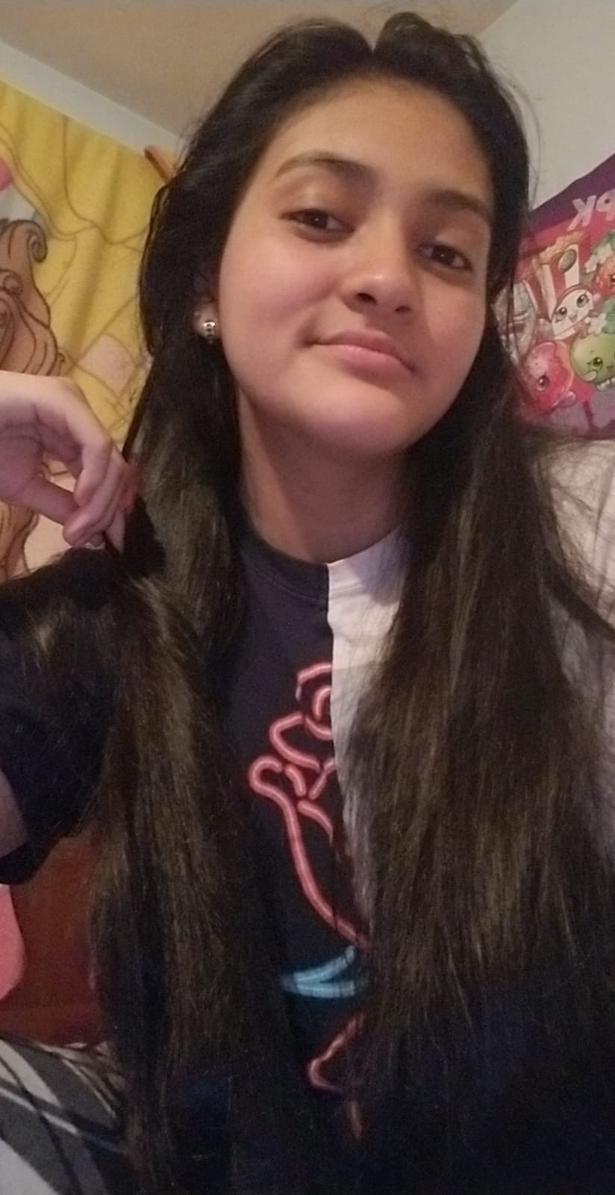
Student participants say it best!
Please welcome Karla Canales!
Life, Listen to me! Vida, Escúchame!
https://longislandwins.com/herstory/stories-for-liberation-life-listen-to-me-by-karla-canales/

Slide 11
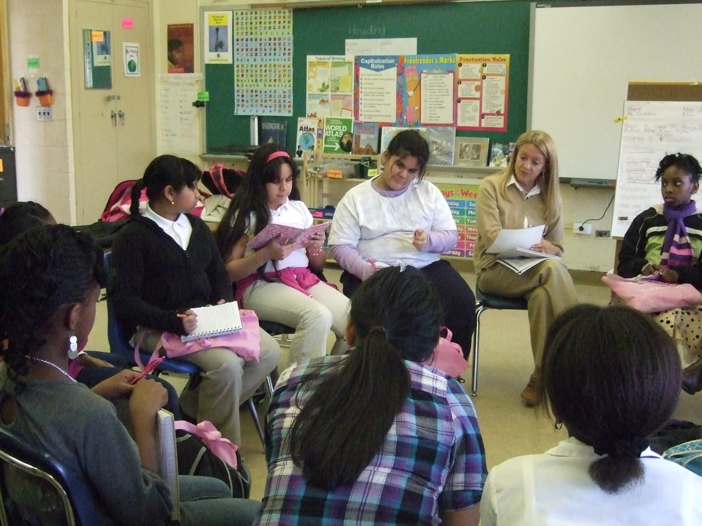
We have adapted the flexible Herstory Method of in-person teaching/learning…...
--

Slide 12
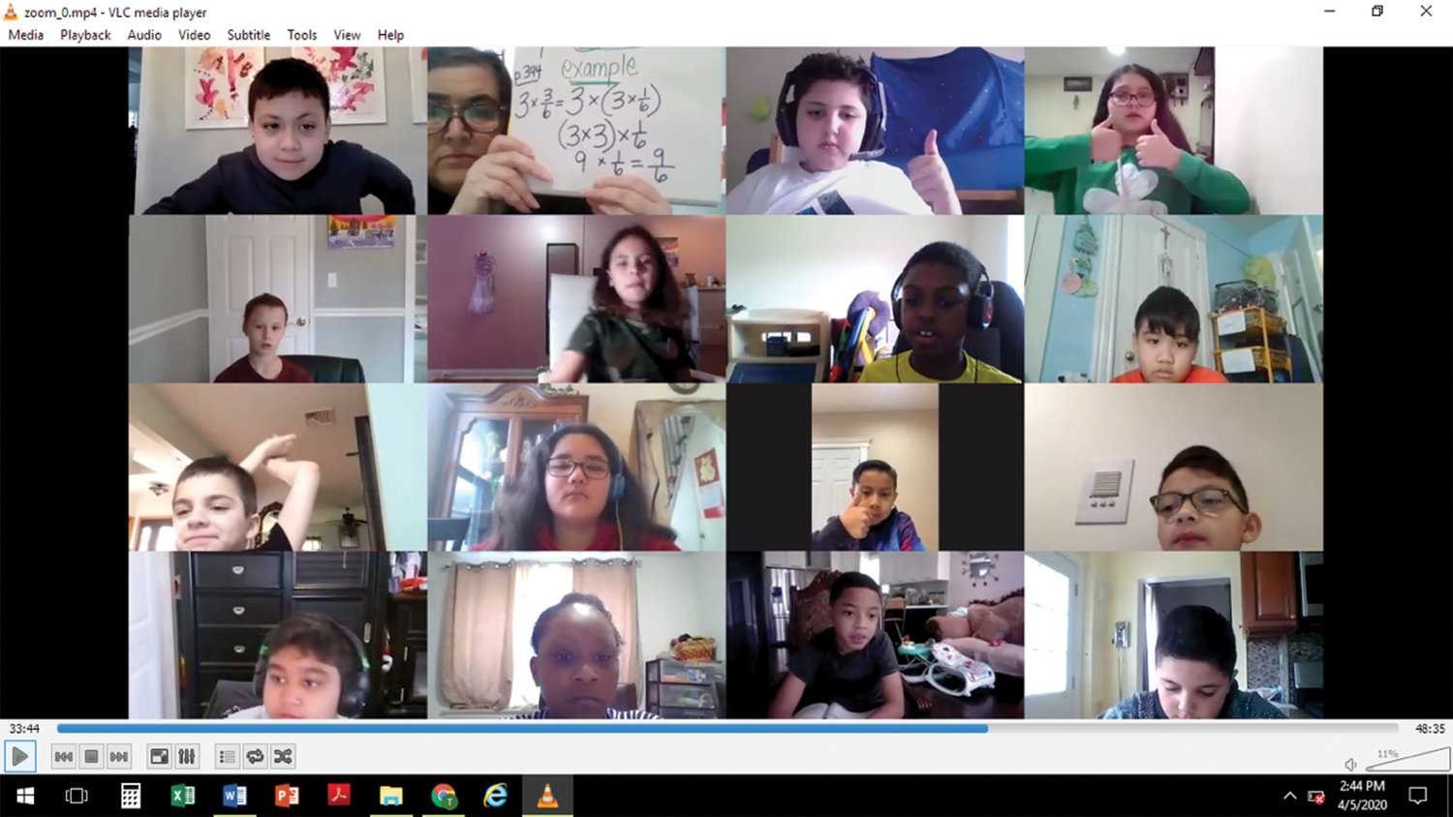
... to remote learning for ELLs throughout NYS!

Slide 13
Focus on all 4 language skills & more!
With remote live learning in small groups,
students benefit from conversations that spark their “page one moments”.
This type of writing differs from most academic writing tasks. It supports not only students’ literacy skills, but also their oralcy skills. This leads to overall improvement in English language proficiency!
Notes:
​Breaking silence to change hearts, minds and policies

Slide 14
Students well suited for this program:
are willing to share their experiences
like to write, but may not write well for school assignments
want to connect with other young people
want to “be the change they seek”
want to wake up others around them
want to have their voices heard
Notes:
You know your students best!

Slide 15
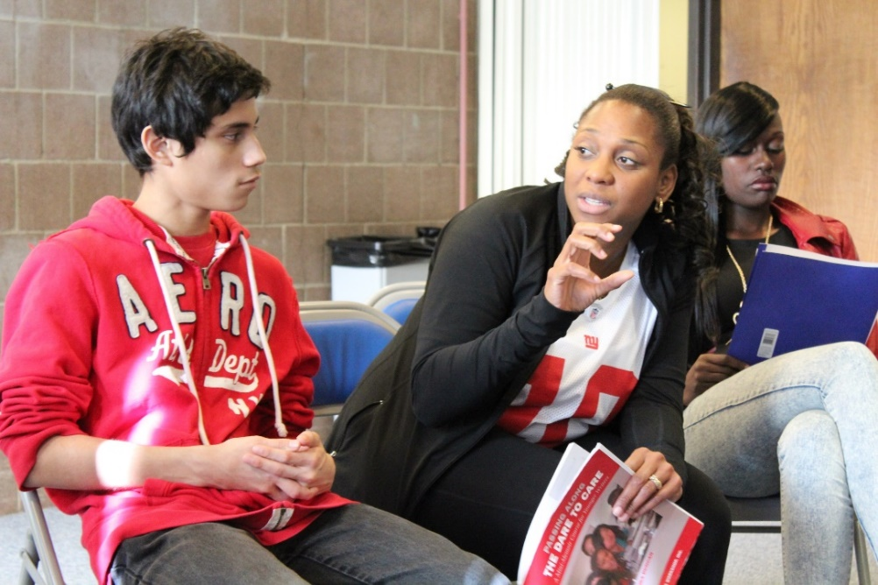
How do you tell a story so that readers will care?
Notes:
Workshop focuses on:
Oral imaging
Sensory memories
Engage your readers in painting a scene

Slide 16
Finding a Dramatic “Page One Moment”
Learning the elements that keep your audience reading and make them care about what has happened particularly to you

Slide 17
Once the writing begins…
The pleasure of sharing a secret with someone who has begun to truly know you through your words, and knowing that your words helped others to embrace your honesty and pain

Slide 18
Writing Participants are expected to:
Be available for 10 two-hour online workshops using ZOOM (video) with internet connection
Be responsible in replying to emails in 48 hours
Be willing to write in whatever language their hopes and dreams exist
Be willing to share their thoughts with others in the group on Zoom
Be willing to share their writing with others in the group on Zoom
Be caring listeners, supportive of others in the group on Zoom
Be able to follow appropriate online behaviors
Have the desire to learn writing strategies to allow their stories to change the hearts and minds of a wide audience
Sign a participant contract agreeing to the above terms
Be willing to share their writing with a wide audience, perhaps at NYS TESOL’s Annual Fall Conference in November 2020 and/or published

Slide 19
https://www.nysut.org/news/nysut-united/issues/2014/april-2014/student-stories-youth-writing-for-justice-project
Next steps…..
Think about students you know who would benefit from this summer’s free writing program.
Look at the guidelines we offer.
Contact your students to gauge their interest level.
Contact us to request a student application Susanne Marcus <susanne.marcusESL@gmail.com
Erika Duncan <eduncan@herstorywriters.org>

Slide 20
See you in November 2020!

